Slide 1
Accelerating Training of DNNs via Sparse Edge Processing
Sourya Dey, Yinan Shao, Keith Chugg, Peter Beerel
ICANN, September 2017

Slide 2
Overview of Current DNNs
Key machine learning technologies
Lot of parameters - Memory intensive
Slow to train - Computationally intensive
Training done offline in CPU/GPU
Custom hardware used for inference only

Slide 3
Highlights of our Research
Predefined sparsity - Memory friendly
30x less parameters in FC layers
Edge-based processing - Computationally flexible
Hardware optimizations - Fast training
35x estimated speedup over GPUs
FPGA based architecture - Online training and inference
Krizhevsky, A., Sutskever, I., Hinton, G.E.: Imagenet classification with deep convolutional neural networks. In: NIPS-2012, pp. 1097–1105 (2012)

Slide 4

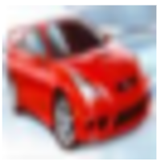

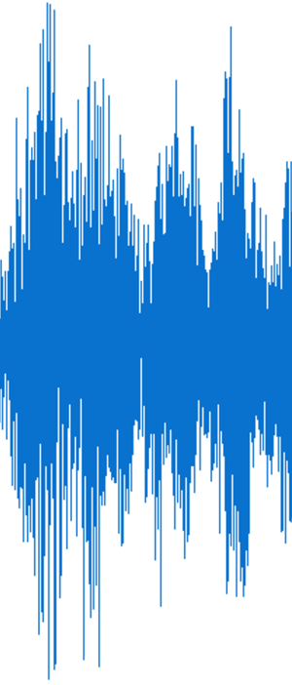
Typical Supervised Network
Convolutional Layers
Pooling and Normalization
Fully Connected Classifier
Predictions
95% of total network connections
5% of total network connections
Krizhevsky, A., Sutskever, I., Hinton, G.E.: Imagenet classification with deep convolutional neural networks. In: NIPS-2012, pp. 1097–1105 (2012)
Zhang, C., Wu, D., Sun, J., Sun, G., Luo, G., Cong, J.: Energy-efficient CNN implementation on a deeply pipelined FPGA cluster. In: ISLPED-2016. pp. 326– 331. ACM, New York (2016)

Slide 5
Focus of the Present Work
Convolutional Layers
Pooling and Normalization
Fully Connected Classifier
Predictions
95% of total network connections

Slide 6
Sparsity
Sparsity – Predefined
Fully connected (FC) network
Sparse network
fo = 1, fi = 2
Connectivity = 25%
Fanout (fo) = 4
Fanin (fi) = 8
Connectivity = 100%

Slide 7
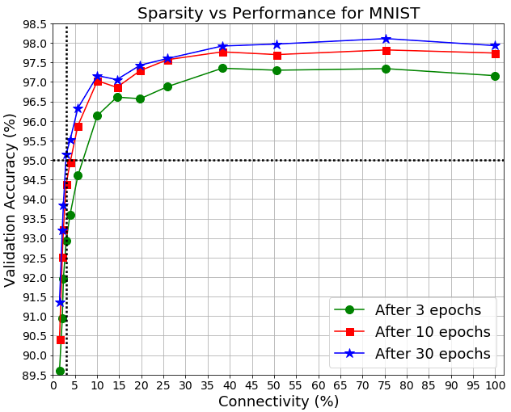
Does predefined sparsity work?
Ongoing research shows:
Results can be further improved by planning connections
Trend holds for other datasets like CIFAR-10
3% connectivity gives >95% MNIST accuracy, within 3% of FC
Notes:
These do NOT use CNNs or more hidden units, both of which can make this absolutely state-of-the-art, i.e. >99%

Slide 8
Interleaving and Spread
I(0)
I(1)
I(2)
I(3)
I(4)
I(5)
I(6)
I(7)
I(0)
I(1)
I(2)
I(3)
I(4)
I(5)
I(6)
I(7)
I(0)
I(1)
I(2)
I(3)
I(4)
I(5)
I(6)
I(7)
0
1
2
3
4
5
6
7
I(0)
I(1)
I(2)
I(3)
I(4)
I(5)
I(6)
I(7)
0
1
2
3
4
5
6
7
Interleaver algorithm ensures:
Each output connected to a good chunk of different inputs
No neuron unconnected
☹
☹
Interleaver
Interleaver
Interleaver
Interleaver
Junction 1
Junction 2

Slide 9
Edge Processing
Concurrent Network Processes
Feedforward (FF) - Weights and activations
Backpropagation (BP) - Weights, deltas and activation derivatives
Parameter Update (UP) - Weights, deltas and activations
Weights (edges) used in all processes
Single weight memory bank
Process z sets of parameters together
z = Degree of parallelism

Slide 10
Memory Organization
z memories for all parameters
Read 1 entry from each memory at a time
Mem 1 | Mem 2 |  |  |  | Mem z
Mem 1 | Mem 2 |  |  |  | Mem z
Clash-free access ☺
Clash stalls processing ☹
Avoid clashes!

Slide 11
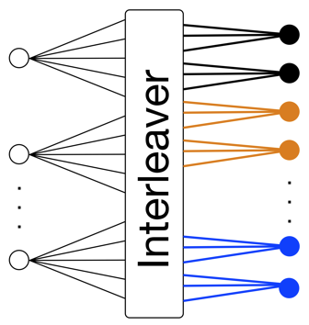
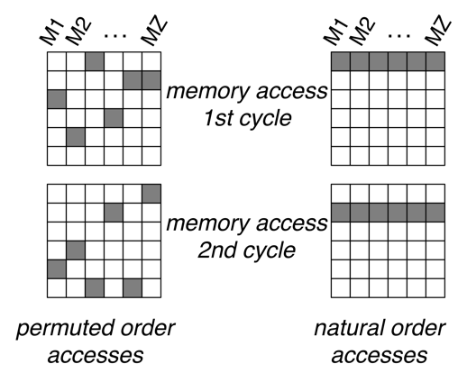

Order of Accesses
Interleaver must prevent clashes
Example: z=6
Permuted order accesses for previous layer parameters
Natural order accesses for junction weights and next layer parameters

Slide 12
Operational Parallelization in a Junction

Slide 13
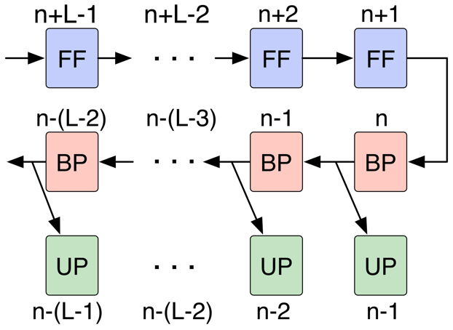
Pipelining across Junctions - Speedup

Slide 14
Architecture Flexibility
Hardware Complexity, Area and Power
z increases
Processing Time
Changing z makes architecture automatically adapts to problem size and available hardware.
Suitable for FPGA reconfigurability
Notes:
Big FPGAs or FPGA farms can support large z

Slide 15
Hardware Simulations
Verilog RTL on MNIST dataset
1024 Input
Neurons
64 Hidden
Neurons
16 Output
Neurons
fo=8
fi=128
fo=8
fi=32
Interleaver
Size = 8192
Interleaver
Size = 512
z = 512
z = 32
Connectivity = 12.5%
Connectivity = 50%
Overall connectivity = 13%

Slide 16
RTL Fixed Point Results vs Floating Point
3b integer +
7b fractional
Fixed point − Floating point
Moving average of last 1000 samples
Total 100K
samples

Slide 17
Summary and Outstanding Issues
Flexible hardware architecture for online training and inference
Predefined sparsity reduces memory and computational complexity
Speedup due to operational parallelization and junction pipelining
Extend to other types of neural networks
Memory bandwidth bottlenecks
Theoretical exploration of connectivity patterns

Slide 18
Thank you!
Questions?
Contact: souryade@usc.edu

Slide 19
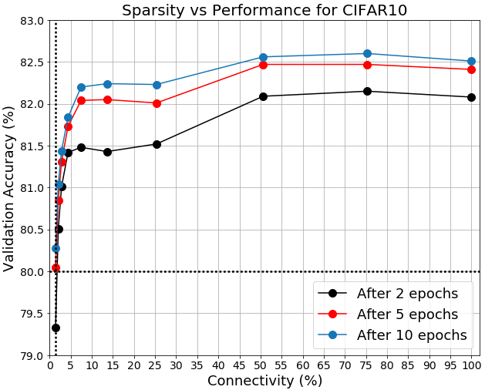
Performance Analysis of Sparsity
3% connectivity gives >95% accuracy in MNIST after 30 epochs, within 3% of FC
1.41% connectivity gives >80% accuracy in CIFAR10 after 5 epochs, within 2.5% of FC
Notes:
PAB: As discussed, I think you can remove the CIFAR data as this was not on the paper.

Slide 20
